Slide 1
Movie Wars
South Tech Week 2020

Slide 2

Material of the workshop
Clone the repository
> git clone https://github.com/Ellyster/STW2020-MovieWars.git
And follow the README.md instructions to get it running

Slide 3


About us
Manuel Ruiz Cardenas
Associate Data Scientist @ Unit4
Manuel.Antonio.Ruiz.Cardenas@unit4.com
Alonso Gragera Aguaza
ML Expert @ Unit4
Alonso.Gragera.Aguaza@unit4.com

Slide 4
Goals of the workshop
Understand the recommendation problem
Know the classification of available approaches for building recommender systems
Learn how to handle the power of “The Data” with preprocessing and predictive models
Know how to prototype and compare models from the points of view of both, Data Scientists and a ML Engineers
Become aware of the powers and dangers of the Dark Side of “The Data”

Slide 5

Disclaimer
Obviously, we don’t own any of the Star Wars copyrights, they belong to Lucasfilm LLC and The Walt Disney Company. It is used under the parody & educational fair use of the copyright act.
The datasets used for this workshop is publicly available at MovieLens website.
Unit4 does not provide services such as Unit4 Videoclub or Movies4U, neither in Naboo nor anywhere else in the know galaxy… yet.
Notes:
Instead of just following one of the many tutorials online on how to build a recommender system, we thought that it will be more beneficial to give you the full picture on how a company may start a project of this indole to add recommendations to one of their products.
In the case of Unit4 it could be:
- Training material recommendations to employees in Intuo
- Courses recommendations to students in Student Management
- Supplier recommendations to companies in Unit4 ERP
But since we cannot use real data from our customers, we decided in the ficticious scenario of movie recommendations in the Galactic Republic HoloNet.

Slide 6

Contents of the workshop
Sense
Episode I – The Phantom Problem
Episode II – Attack of the Data
Episode III – Revenge of the Outliers
Control
Episode IV – A New Pipeline
Episode V – The Training Strikes Back
Episode VI – Return of the Metrics
Alter
Episode VII – The Model Awakens
Episode VIII – The Last Hyper-parameter
Episode IX – The Rise of Predictions
BONUS: The Dark Side of “The Data”

Slide 7


Slide 8

Episode I – The Phantom Problem
What is a Recommender System?
Recommender systems collect information from users’ preference for a set of items and predict the best desired items for them. The information can be obtained explicitly by recording users’ ratings or implicitly by observing users’ behavior.

Slide 9
Episode I – The Phantom Problem
What is Machine Learning?
Machine learning uses known data to find patterns in order to make predictions on new, unknown data.
What are Features and Labels?
The inputs for machine learning are called Features, which are the attributes used to make predictions. The output of machine learning is called the Label or Target, which is the actual prediction.

Slide 10

Episode II – Attack of the Data
“The Data” is what gives a Data Scientist its power, is an binary field created by all living things. It surround us. It penetrate us. It binds the galaxy together.
Let’s check the Episode II notebook

Slide 11
Episode III – Revenge of the Outliers
Now we’ll see how to preprocess, repeat with me:
I am one with The Data; the Data is with me.
Let’s check the Episode III notebook

Slide 12
Episode IV – A New Pipeline
The main types of recommender systems are:
Content-based filtering
Use solely attributes about users and/or items but not their interactions.
Item profile: Use genre, year, actors, director or any other movie information for classifying movies
User profile: Use age, gender, job or any other personal information for classifying users
Collaborative filtering
Use solely information on the past interactions recorded between users and items.
User-user collaboration: When two users like the same movie, it means that the users are similar.
Item-item collaboration: When two movies are liked by the same user, it means that the movies are similar.
Hybrid
Use a mix of both types of information.

Slide 13
Episode IV – A New Pipeline
Content-based filtering
Advantages
The user gets recommended the types of items they love.
The user is satisfied by the type of recommendation.
New items can be recommended; just data for that item is required.
Disadvantages
The user will never be recommended for different items.
Business cannot be expanded as the user does not try a different type of product.
Collaborative filtering
Advantages
New products can be introduced to the user.
Business can be expanded and can popularize new products.
Disadvantages
User’s previous history is required or data for products is required based on the type of collaborative method used.
The new item cannot be recommended if no user has purchased or rated it.
More info: https://www.youtube.com/watch?v=Eeg1DEeWUjA

Slide 14
Episode V – The Training Strikes Back
The ability to be trained does not make it an intelligent model, you should explore all options.
Let’s check the Episode V notebook

Slide 15
Episode VI – Return of the Metrics
Only a Sith deals in absolutes, there is not such thing as THE METRIC.
Let’s check the Episode VI notebook

Slide 16
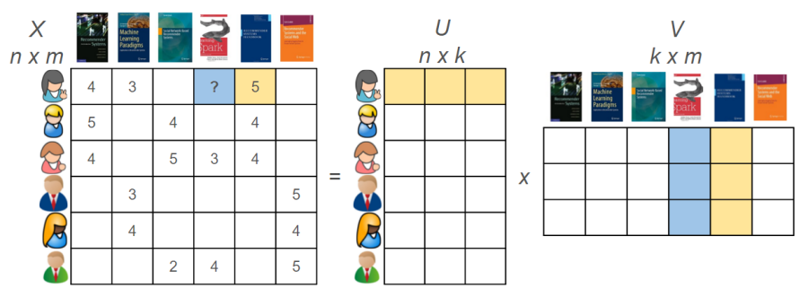
Episode VII – The Model Awakens
Matrix Factorization is a collaborative filtering algorithm
It decomposes the an approximation of the rating matrix as the product of an user features and a movie features matrices in order to save space.

Slide 17
Episode VII – The Model Awakens
What is MLContext?
MLContext is the starting point for all ML.NET operations. The MLContext is used for all aspects of creating and consuming an ML.NET model. It is similar conceptually to DbContext in Entity Framework.

Slide 18
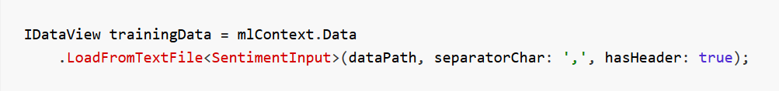
Episode VII – The Model Awakens
What is a DataView?
Data in ML.NET is represented as an IDataView, which is a flexible, efficient way of describing tabular data.
IDataView objects can contain numbers, text, booleans, vectors, and more.

Slide 19
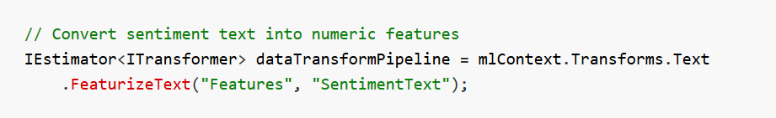
Episode VII – The Model Awakens
What is a transformer?
In most cases, the data that you have available isn't suitable to be used directly to train a machine learning model. The raw data needs to be pre-processed using data transformations.

Slide 20
Episode VII – The Model Awakens
What is a estimator?
An estimator is an 'untrained transformer'. It needs to 'fit' on the data to manufacture a transformer. It what we usually regard as a model.

Slide 21
Episode VII – The Model Awakens
What is a pipeline?
A machine learning pipeline IEstimator<ITransformer> is a chain of several pre-processing transformers, an estimator model and several post-processing transformers.

Slide 22
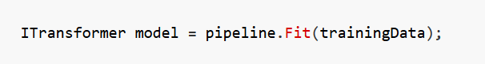
Episode VII – The Model Awakens
What is fitting a model?
The data transformations and algorithms you have specified are not executed until you call the Fit() method. This is when model training happens, and the estimator gets replaced by the trained transformer.

Slide 23
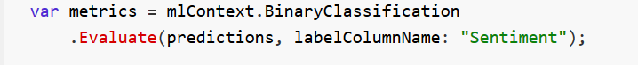
Episode VII – The Model Awakens
What is model evaluation?
Is just transform the already trained pipeline and its context in a binary format so that it can be stored.
Which are the Matrix Factorization metrics?
The it can be evaluated same as a regression model. This means that we can use R² and Mean Average Error.

Slide 24
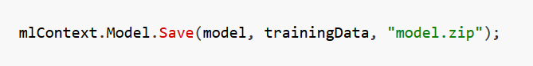
Episode VII – The Model Awakens
What is model serialization?
Is just transform the already trained pipeline and its context in a binary format so that it can be stored.
What is MLOps?
Is to treat ML models as code, versioning our experiments and doing continuous deployment of the results.

Slide 25
Episode VII – The Model Awakens
Now, it’s time to build our production model. For my ally is The Data, and a powerful ally it is.
Let’s check the ML.NET project

Slide 26
Episode VIII – The Last Hyper-parameter
What are hyper-parameters?
The hyper-parameters are just parameters that modify the way a model is trained.
Which are the Matrix Factorization ones?
ML.Net’s Matrix Factorization implementation has two hyper-parameters:
NumberOfIterations the number of iterations that the approximation algorithm performs, increases accuracy and training time.
ApproximationRank: the number of features that we use for the users and movies matrices, increases accuracy and model size.

Slide 27
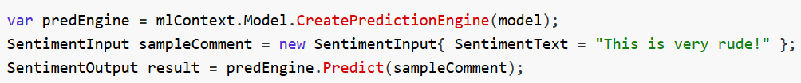
Episode IX – The Rise of Predictions
What is a prediction engine?
Is a way of executing the pipeline optimized for individual predictions.
Individual or Batch predictions?
For individual predictions is better to use Predict(), for doing several predictions in batch is better to use Transform().

Slide 28
Thank you!
And may the Data be with you!

Slide 29
The dark side of the force Personal information
“When you look at the dark side, careful you must be… for the dark side looks back.”
See the Dark Side notebook

Slide 30

The dark side of the force Personal information
The Jedi fight for obtaining ratings using the information about users and movies.
Conversely we, The Sith, fight for control all users using the information of provided by their ratings, this is the true path. We wont rest until everyone is identified.

Slide 31

The dark side of the force Personal information
Current dark side agenda:
What is your gender?
77% accurate
What is your age?
± 2,7 years
What is your occupation?
73% accurate

Slide 32

The dark side of the force Personal information
Further goals of the dark side cause:
Are you happy/in love/depressed?
Are you married/single?
How many kids you have? And how old are they?
What is your political opinion?
What is your sexual orientation?
How much is your income?
What is your work schedule?

